Slide 1





This project was made possible with the support of :
Master Plumbers Association Tasmania
Mental Health Project
February, 2026.
Launch Date - World Plumbing Day March 11, 2026.

Slide 2




February, 2026
Introducing our Mental Health Project:
Thanks to funding by Keystone Tasmania, Master Plumbers Association of Tasmania is proud to present an industry-focussed program to meet the needs of our plumbing businesses and employees.
Introducing: “ Get the Pressure Down for Mental Health” Project Team.
Natalie Kingston, MPATAS
Industry Engagement Officer
Fiona McCarthy, AIHS Certified OHS Professional
WorkPS Pty Ltd
Gavin Evans
Artwork and Media Assets
“Gift of the Gav”

Slide 3

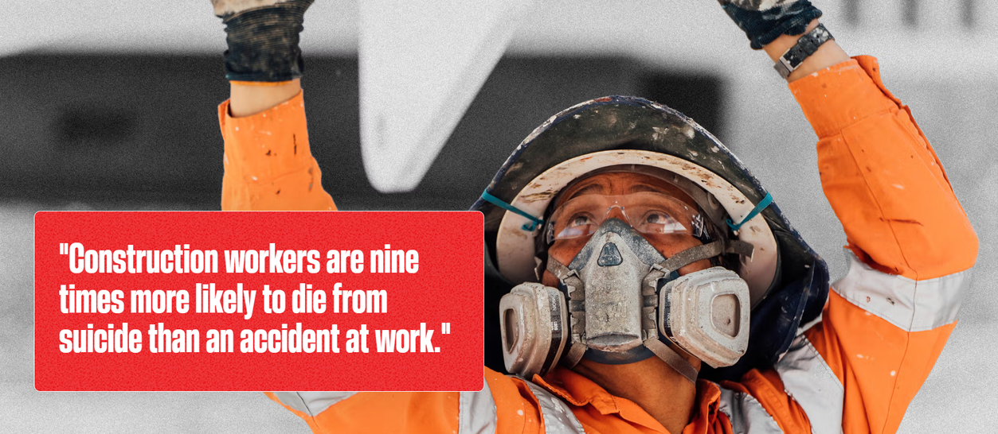
Why Mental Health?
Mental health skills, knowledge and access to resources are vitally important in today’s construction workforce, where safety and injury prevention are top of mind. They are also key to risk management in this highly regulated space.
The “Get the Pressure Down for Mental Health” program will enable businesses and employees to access free resources in digital or paper formats that put Mental Health at Work front of mind. The launch of the program is World Plumbing Day on March 11, 2026. This resource is intended as a starting point for engagement in mental health conversations at work.
We need to take serious action to prevent harm in the Construction Industry. Source: Mates in Construction website.

Slide 4
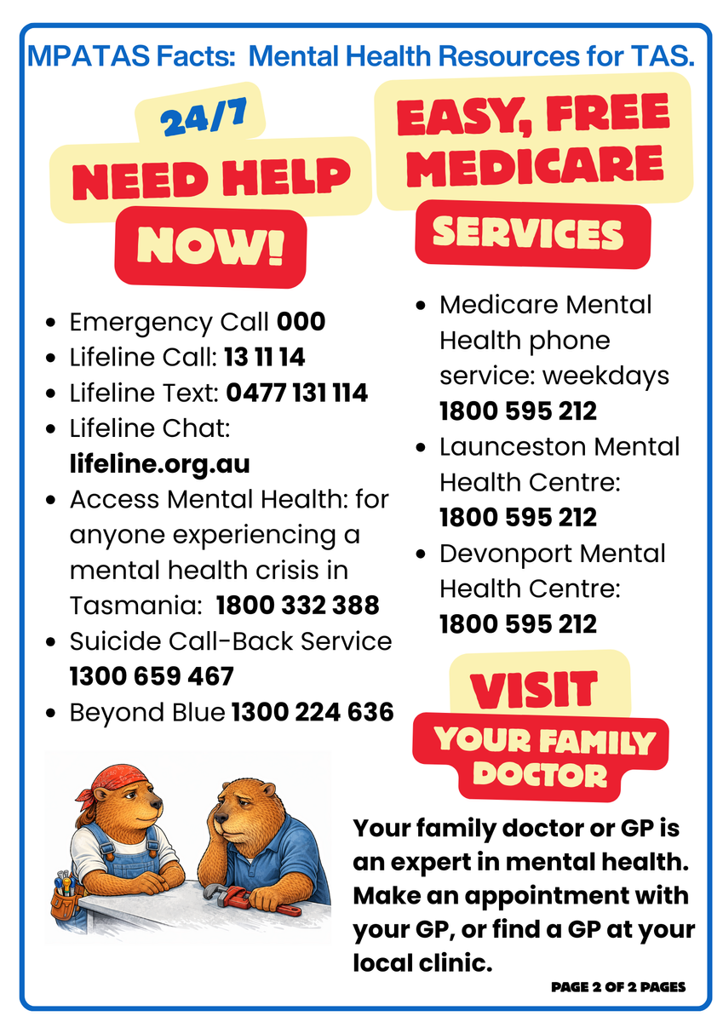

Trigger Warning
If you feel sad or upset during this presentation or afterwards, please reach out for help.
OUR FACTSHEETS ALL CONTAIN A RESOURCE LIST: CHECK THEM OUT ON MPATAS.COM.AU
Here is the resource page!

Slide 5


Rimberio
June 13, 2038
Factsheets:
Project Goals:
Double-sided with resources on every factsheet page 2.
Why Mental Health at Work?
3 Top Tips for Mentally Safe Work
Manage Psychosocial Hazards
Talking Mental Health with Workmates
Respect@Work - Gender and Sex-based harassment‘
1.To show the importance of mental health at work
2.To improve our ability to identify and respond to a mental health challenge
3.To improve our confidence to seek mental health support, when we need it
4.To improve our confidence to talk about mental health issues
5.To improve business knowledge of how to manage workplace psychosocial hazards.
Resources:
Toolbox Talk to run at workplaces
Mental Health Resources available in Tasmania in digital and paper formats
Evidence-informed information in readable and usable formats
Media resources to attract attention and engagement.

Slide 6
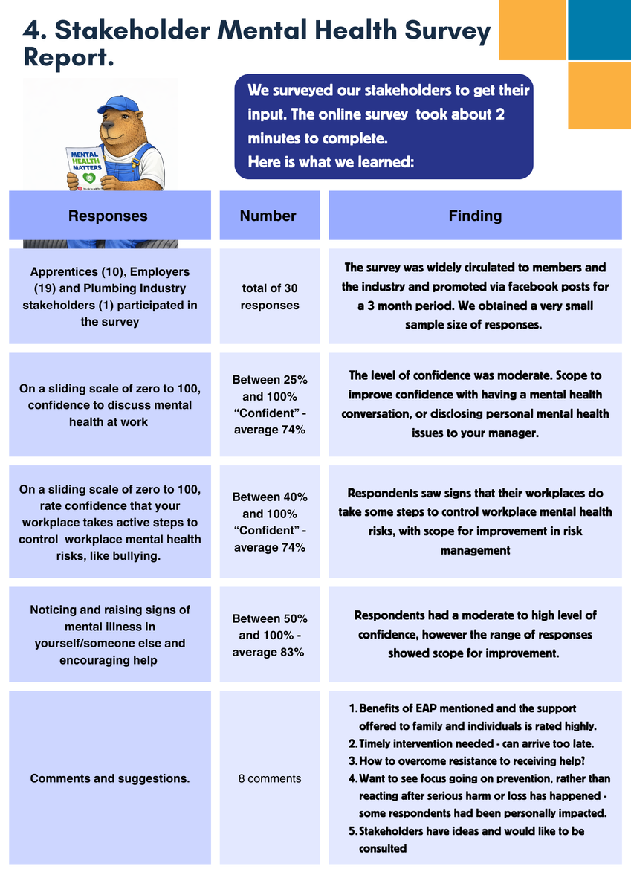
Stakeholder Consultation
We surveyed stakeholders to get their input.
The online survey took about 2 minutes to complete. The same questions will be used to check in with stakeholders after the program is launched and running for 3 months, to understand the impact of the program.
We will be looking for an uplift in overall confidence and resource knowledge. We will also be looking for an uplift in perceptions on how workplaces manage psychosocial risk.

Slide 7
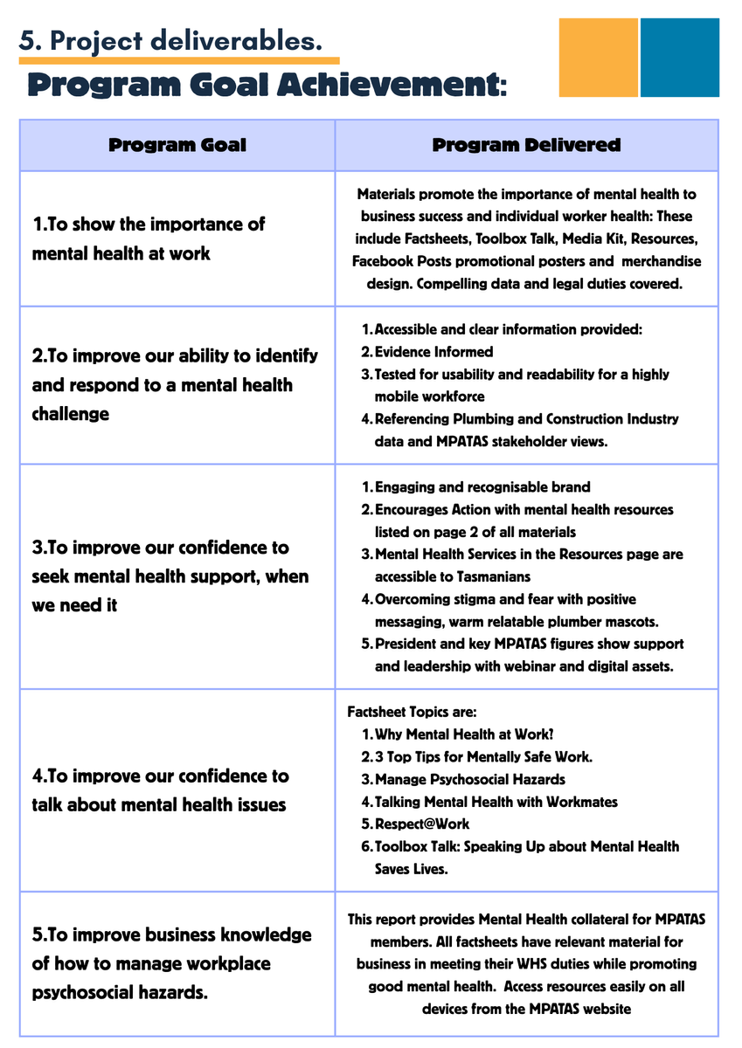
Evaluation and review are recommended, to assess the quality and effectiveness of the campaign, by focussing on these recommended indicators of success:
Compare
Pre and post survey results as a measure of confidence with mental health topics
Feedback
Qualitative feedback on the program
Likes
Posts on social media likes and comments
Traffic count visiting website - compared to usual traffic
Hits
Attendees and participation Events and use of Toolbox Talk.
Events

Slide 8
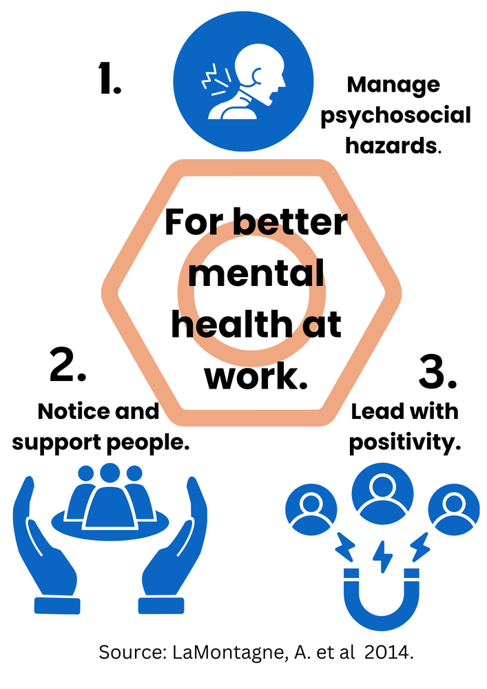
Summary:
Mental health skills, knowledge and access to resources are vitally important in today’s construction workforce, where safety and injury prevention are top of mind. They are also key to risk management in this highly regulated space.
The “Get the Pressure Down for Mental Health” program will enable businesses and employees to access free resources in digital or paper formats that put Mental Health at Work front of mind. The launch of the program is World Plumbing Day on March 11, 2026. This resource is intended as a starting point for engagement in mental health conversations at work.
Our stakeholder survey (business owners, plumbers, apprentices and other groups) and review of national and Tasmanian work health and safety data for the Construction workforce provided the basis for a focussed and evidence-informed program.

Slide 9


Thank You!
MPATAS is putting it out there for mental health in the plumbing industry. We know that getting on-board with mental health at work saves lives. Please visit our website and check out our “Get the Pressure Down” Campaign and resources for your team.
www.mpatas.com.au

